Slide 1

Assignment -4 Sentiment Analysis for Tweets
Kavuri Mahesh - 200545458
Jahir Abbas - 200546259

Slide 2
Sentiment Analysis on Twitter Data using Python and Azure
Introduction:
In this presentation, we will explore the fascinating world of sentiment analysis using a robust dataset called Sentiment140. This dataset contains 1.6 million tweets collected from Twitter, a popular social media platform. Sentiment analysis, also known as opinion mining, uses natural language processing, text analysis, and computational linguistics to identify and extract subjective information from source materials.
About the Dataset:
Dataset Link:- https://www.kaggle.com/datasets/kazanova/sentiment140
The Sentiment140 dataset, initially used in a Stanford University project, is made up of Twitter statuses that have been automatically labeled as negative or positive. This labeling is based on the presence of specific emoticons in the tweets. The data fields include:
Polarity: the sentiment of the tweet (0 = negative, 2 = neutral, 4 = positive)
ID: the id of the tweet
Date: the date of the tweet
Query: the query used to collect the tweet
User: the user that tweeted
Text: the text of the tweet

Slide 3

Sentiment Analysis on Twitter Data using Python and Azure
About the Python Process:
We utilize Python, a powerful programming language known for its readability and versatility in data analysis tasks, to pre-process and analyze the data. The process includes the following steps:
Data Cleaning: Remove unnecessary columns, handle missing data, and clean the tweet text (remove special characters, URLs, numbers, etc.)
Text Preprocessing: Tokenize the text (split it into individual words), and remove stop words (commonly used words like 'the', 'is', 'in', etc.)
Vectorization: Convert the preprocessed text into a numerical format that can be understood by machine learning algorithms. We used the Bag of Words model for this purpose.
Model Training: Train a logistic regression model using the vectorized text.
Evaluation: Evaluate the model using accuracy, precision, recall, and F1-score.
GITHUB LINK: -

Slide 4
Objectives
Understand the data: The first objective is to understand the nature and structure of the data contained in the Sentiment140 dataset. This involves looking at the distribution of data, the type of data (numerical, categorical, text), and any irregularities or inconsistencies in the data.
Preprocess the data: The next objective is to preprocess and clean the data for further analysis. This involves removing unnecessary features, cleaning text data, handling missing data, and converting text into a format that can be processed by machine learning algorithms.
Perform Sentiment Analysis: The main objective is to perform sentiment analysis on the dataset. This involves training a machine learning model to predict the sentiment of a tweet based on its content. The model is evaluated on its ability to accurately predict sentiment on unseen data.
Provide Insights: Another important objective is to provide insights from the analysis. This could be about the distribution of sentiments in the dataset, the most common words in positive and negative tweets, the accuracy of the sentiment prediction model, etc.
Visualize the data: The final objective is to visualize the data and the results of the sentiment analysis. This involves creating graphs and charts to visualize the distribution of sentiments, word frequency, model performance metrics, etc.

Slide 5
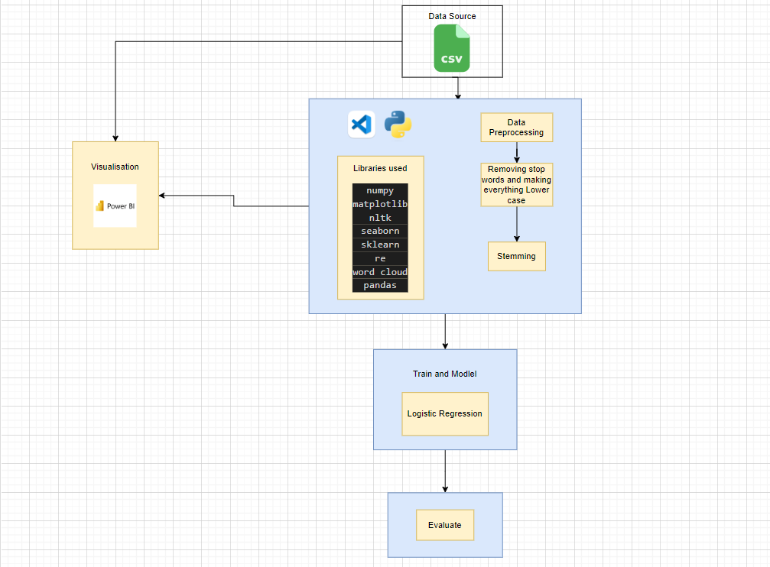
Architecture

Slide 6
Explanation of Architecture
Load Dataset: The first step is to load the Sentiment140 dataset into a pandas DataFrame. Pandas is a data manipulation library in Python. This can be achieved using the pandas.read_csv() function. The data file contains the following fields: polarity, ID, date, query, user, and text of the tweet.
Data Cleaning: Once the data is loaded, we start with data cleaning. In this step, unnecessary columns are dropped using the pandas.drop() function. The columns 'ID', 'date', 'query', and 'user' are not useful for our sentiment analysis task, so we drop these columns. The 'polarity' column is relabeled to 'target' and the values are mapped from {0, 2, 4} to {Negative, Neutral, Positive}.
Preprocessing: The next step is preprocessing the text of the tweets. The raw tweets are processed by:
Removing special characters, numbers, and URLs using regular expressions.
Tokenizing the text (splitting the text into individual words) using the nltk.word_tokenize() function.
Removing stop words (commonly used words like 'the', 'is', 'in', etc.) using the NLTK library's list of English stop words.
Applying stemming (reducing words to their root form) using the Porter Stemmer from the NLTK library.
Vectorization: After preprocessing the text data, we need to convert the text into a numerical format that can be understood by machine learning algorithms. This is known as vectorization. We use the Bag of Words model, which represents each document as a bag of its words, disregarding grammar and word order but keeping the multiplicity. We limit the number of features to 5000 most frequently occurring words to keep the feature vector size manageable. This is achieved using the CountVectorizer() function from the sklearn library.
Splitting the Data: The dataset is split into a training set and a testing set using the train_test_split() function from the sklearn library. This helps to validate the performance of the model.
Model Training: A logistic regression model is trained using the training data. Logistic regression is a suitable model for binary classification tasks like sentiment analysis. The model is trained using the LogisticRegression().fit() function from the sklearn library.
Model Evaluation: After the model is trained, it is evaluated on the testing data. The performance of the model is assessed using accuracy, precision, recall, and F1-score. These metrics give a comprehensive understanding of the model's performance. They are calculated using the respective functions from the sklearn library (accuracy_score(), precision_score(), recall_score(), f1_score()).

Slide 7
Pros of Sentiment Analysis on Twitter Data
Uncover Insights: Sentiment analysis can uncover insights that may not be immediately apparent through casual observation. It can identify overall trends in sentiment, key topics that generate positive or negative sentiments, and shifts in sentiment over time.
Scalability: Sentiment analysis allows businesses to analyze large volumes of data that would be impractical to review manually. It's a powerful tool for handling the vast amount of data generated on social media.
Real-time Analysis: Sentiment analysis can be performed in real time, allowing businesses to react quickly to shifts in public opinion or respond promptly to customer feedback.
Customer-centric Approach: It helps in understanding customer sentiment and feedback, which can help businesses align their products and services more closely with customer needs and preferences.

Slide 8
Cons of Sentiment Analysis on Twitter Data
Context Understanding: Sentiment analysis algorithms may struggle with understanding context, irony, sarcasm, and other nuances of human language. This can lead to incorrect sentiment classification.
Data Quality: The quality of the analysis is highly dependent on the quality of the data. If the data is biased or incomplete, the sentiment analysis results will also be flawed.
Language Limitations: Some sentiment analysis tools might not support all languages, which might limit their applicability in a multilingual context.

Slide 9
Business Impact of Sentiment Analysis on Twitter Data
Improved Customer Service: Businesses can use sentiment analysis to monitor customer feedback in real time, identify issues, and resolve them promptly, leading to improved customer satisfaction and loyalty.
Product Development: By analyzing customer sentiment, businesses can identify what customers like or dislike about their products and use this feedback to make improvements or develop new products.
Marketing and Sales Strategy: Understanding customer sentiment can inform marketing and sales strategies. For instance, products with positive sentiment can be promoted more heavily, while negative sentiment can indicate a need for strategy adjustment.
Brand Reputation: Monitoring sentiment can help businesses manage their brand reputation by alerting them to shifts in public opinion and giving them the opportunity to address negative sentiment proactively.
Competitive Advantage: By understanding customer sentiment, businesses can gain a competitive advantage by swiftly acting on customer feedback and market trends.

Slide 10
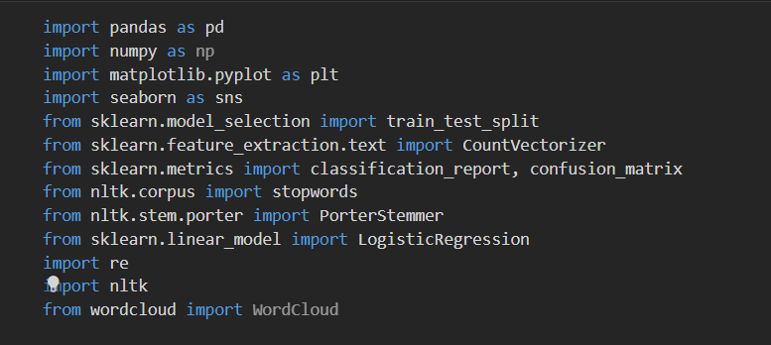
Libraries used in the project

Slide 11
Libraries Functionalities
pandas: This library provides high-performance, easy-to-use data structures and data analysis tools. It's used for loading the dataset into a DataFrame and performing data manipulation tasks like removing unnecessary columns.
numpy: Numpy is a library for the Python programming language, adding support for large, multi-dimensional arrays and matrices, along with a large collection of high-level mathematical functions to operate on these arrays.
matplotlib and seaborn: These libraries are used for data visualization. They provide functions to create a variety of plots and charts.
nltk: The Natural Language Toolkit (NLTK) is used for text preprocessing tasks. It provides functions for tokenizing text (splitting the text into individual words), removing stopwords (commonly used words like 'the', 'is', 'in', etc.), and stemming (reducing words to their root form).
re: The re (regular expressions) library is used for removing special characters, numbers, and URLs from the text of the tweets.
sklearn: The Scikit-learn library provides machine learning algorithms and tools for data analysis. It is used for vectorizing the text data (converting the text into a numerical format that can be understood by machine learning algorithms), splitting the dataset into a training set and a testing set, training a logistic regression model, and evaluating the model.
WordCloud: This library is used for creating word cloud visualizations.

Slide 12
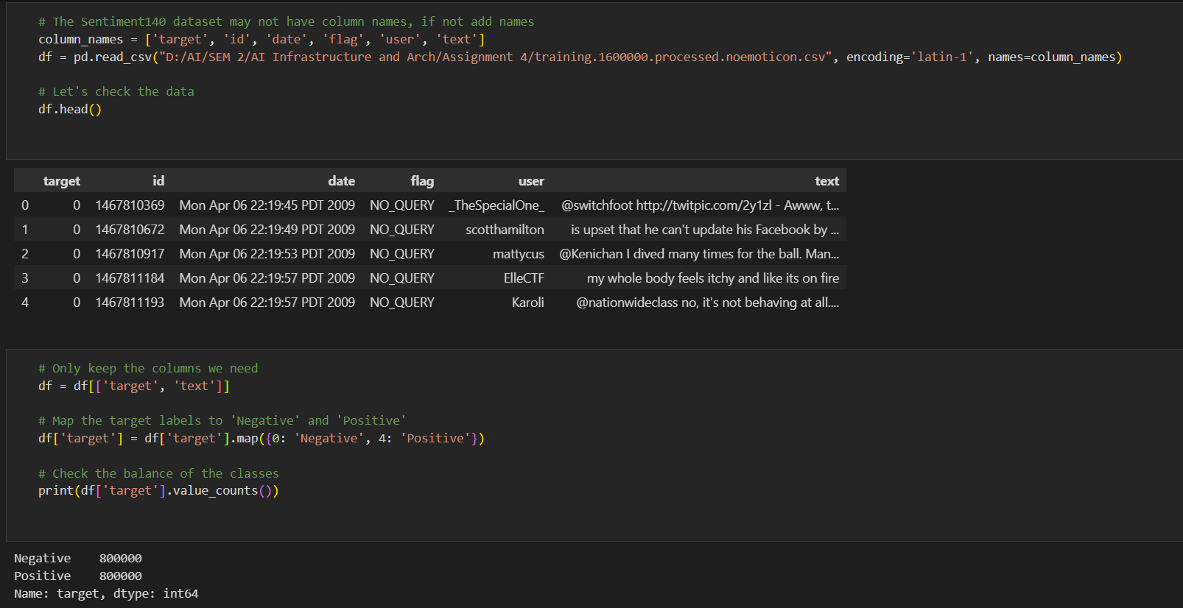
Loading the data and naming columns
In the above we loaded the csv file and assigned the column names for it and displayed first 5 rows of the dataset where we can see the changed column names

Slide 13
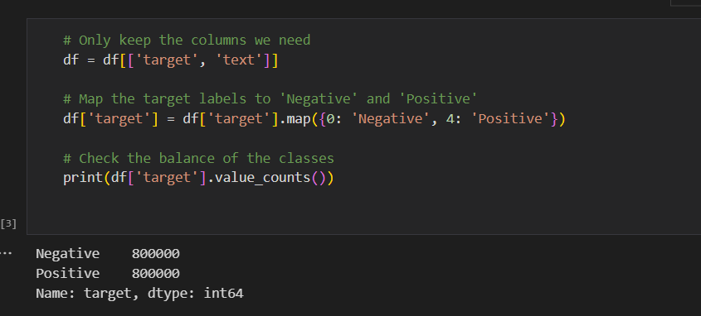
Data Analysis
Only keep the columns we need: df = df[['target', 'text']]
This line is keeping only the 'target' and 'text' columns in the DataFrame df and discarding the rest. The 'target' column represents the sentiment of the tweet (negative or positive), and the 'text' column contains the text of the tweet.
Map the target labels to 'Negative' and 'Positive': df['target'] = df['target'].map({0: 'Negative', 4: 'Positive'})
This line is transforming the values in the 'target' column. Originally, the 'target' column contains values 0 (representing negative sentiment) and 4 (representing positive sentiment). This line is replacing 0 with 'Negative' and 4 with 'Positive' for easier understanding.
Check the balance of the classes: print(df['target'].value_counts())
This line is checking the distribution of negative and positive sentiments in the dataset. The value_counts() function returns the number of instances of each unique value in the 'target' column. It helps in understanding whether the dataset is balanced (i.e., has a similar number of negative and positive tweets) or imbalanced. A balanced dataset generally results in a better performing model.

Slide 14
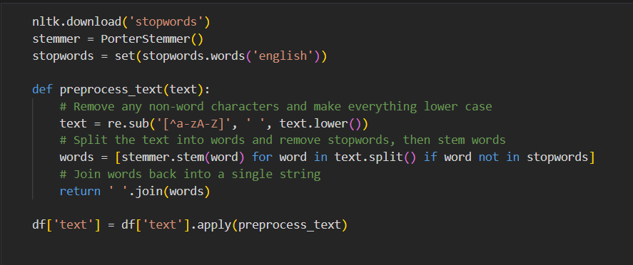
Data Preprocessing
Download stopwords: nltk.download('stopwords')
This line downloads the set of English stopwords (common words like 'the', 'is', 'in', etc.) from the NLTK (Natural Language Toolkit) library.
Define preprocessing function: def preprocess_text(text):...
This function takes a string of text as input and performs several preprocessing steps:
It removes any non-alphabetic characters and converts all the text to lower case.
It splits the text into individual words.
It removes stopwords and applies stemming to the words.
It joins the processed words back into a single string.
Apply preprocessing function to text: df['text'] = df['text'].apply(preprocess_text)
This line applies the preprocess text function to every row in the 'text' column of the Data Frame. The resulting processed text is then stored back in the 'text' column. This means the 'text' column is now ready for vectorization and further analysis.

Slide 15
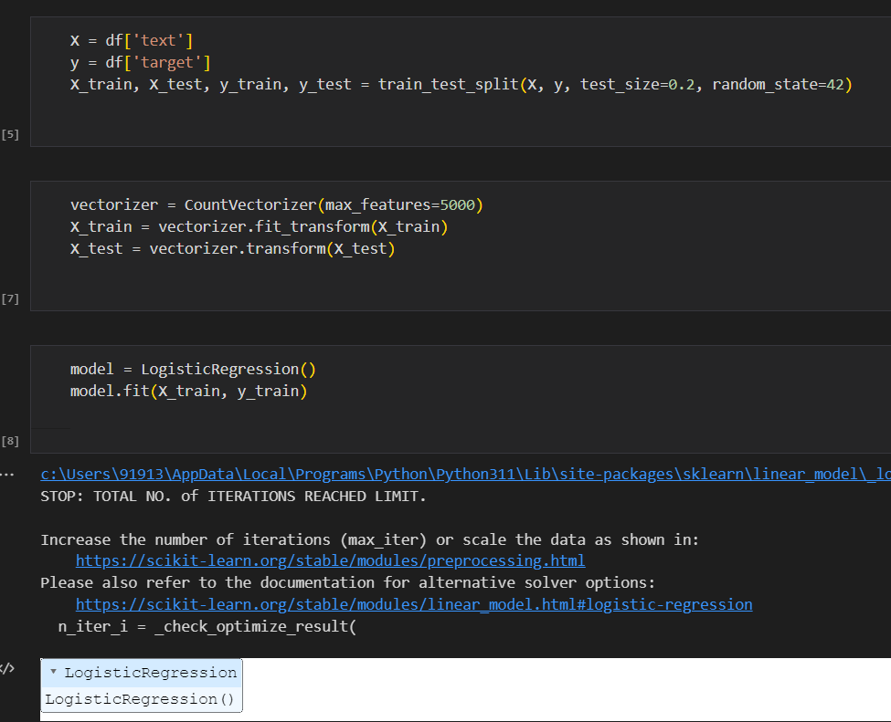
Selecting and fitting the model
Separate features and labels: X = df['text'], y = df['target']
The features (X) and the labels (y) are being separated. X contains the 'text' column (the tweet text), which is the feature we want to base our predictions on. y contains the 'target' column (the sentiment), which is what we want to predict.
Split the data into training and testing sets: X_train, X_test, y_train, y_test = train_test_split(X, y, test_size=0.2, random_state=42)
The data is being split into a training set and a testing set. 80% of the data will be used for training the model, and 20% will be used for testing its performance. The random_state parameter is set for reproducibility - using the same random_state will produce the same train/test split each time.
Vectorize the text data:
vectorizer = CountVectorizer(max_features=5000)
X_train = vectorizer.fit_transform(X_train)
X_test = vectorizer.transform(X_test)
These lines are converting the text data into a numerical format that can be processed by machine learning algorithms. The CountVectorizer function creates a 'bag of words' model - it assigns an integer ID to each word and counts the number of occurrences of each word. The parameter max_features=5000 means that only the 5000 most frequent words will be kept.
Train the machine learning model:
model = LogisticRegression()
model.fit(X_train, y_train)
A Logistic Regression model is being created and trained on the training data. model.fit(X_train, y_train) is where the training occurs - the model learns to associate the tweet texts (X_train) with the sentiments (y_train). After this line, the model is ready to make predictions.

Slide 16
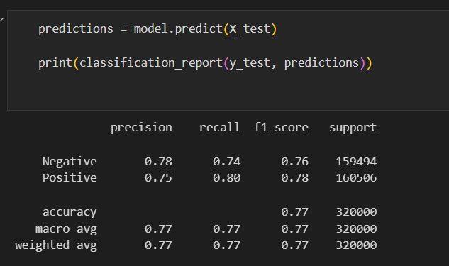
Evaluating the model
Precision: Precision is the ability of a classifier not to label a negative sample as positive. In other words, for each class, it is the ratio of correctly predicted positive observations to the total predicted positives. For instance, for the 'Negative' class, a precision of 0.78 means that 78% of the tweets predicted as negative were actually negative.
Recall (Sensitivity): Recall is the ability of a classifier to find all positive instances. For each class, it is defined as the ratio of correctly predicted positive observations to all observations in actual class. The recall of 0.74 for the 'Negative' class means that the model correctly identified 74% of all actual negative tweets.
F1-score: The F1-score is the harmonic mean of precision and recall. It tries to find the balance between precision and recall. An F1-score is considered perfect at 1, and worst at 0. For the 'Negative' class, the F1-score of 0.76 indicates that the model has a reasonably balanced precision and recall.
Support: Support is the number of actual occurrences of the class in the dataset. For 'Negative', the support is 159494, meaning there are 159494 negative tweets in the dataset.
Accuracy: Accuracy is the ratio of correctly predicted observations to the total observations. An accuracy of 0.77 means the model correctly predicted the sentiment 77% of the time.
Macro avg: The macro average computes the metric independently for each class and then takes the average, treating all classes equally, regardless of their imbalance in the dataset.
Weighted avg: The weighted average calculates metrics for each label, and finds their average weighted by support, which helps in imbalance situations.

Slide 17
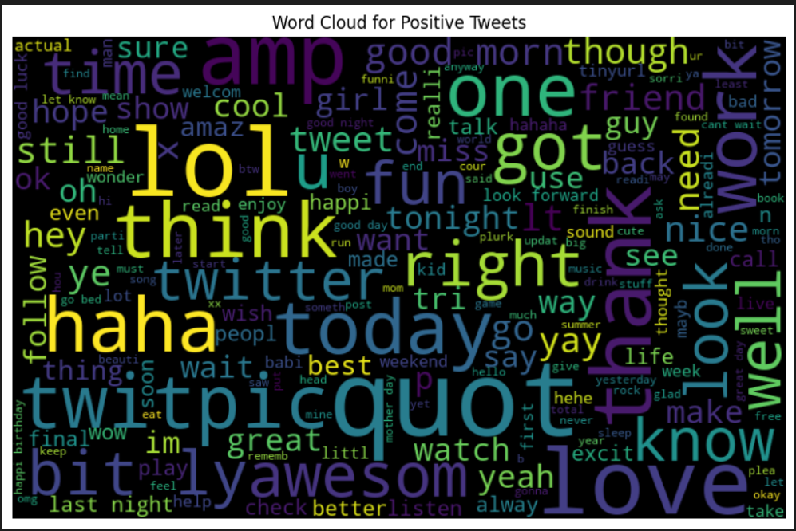
Word cloud Positive reviews

Slide 18
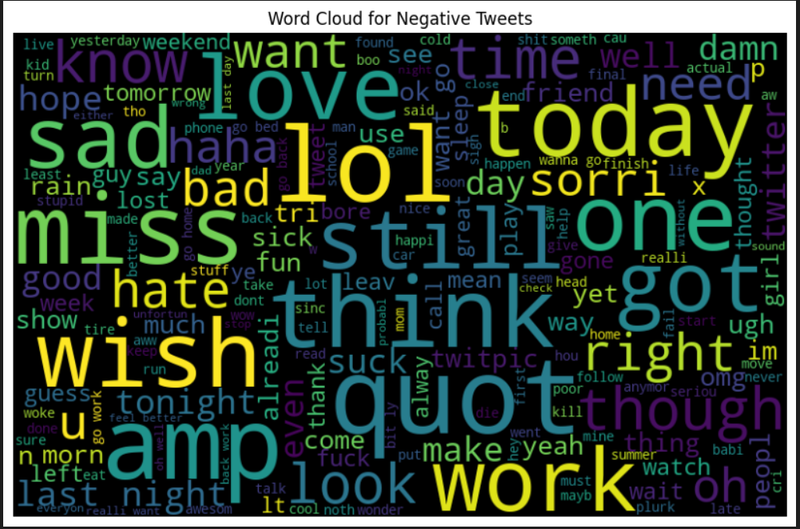
Word cloud Negative reviews

Slide 19
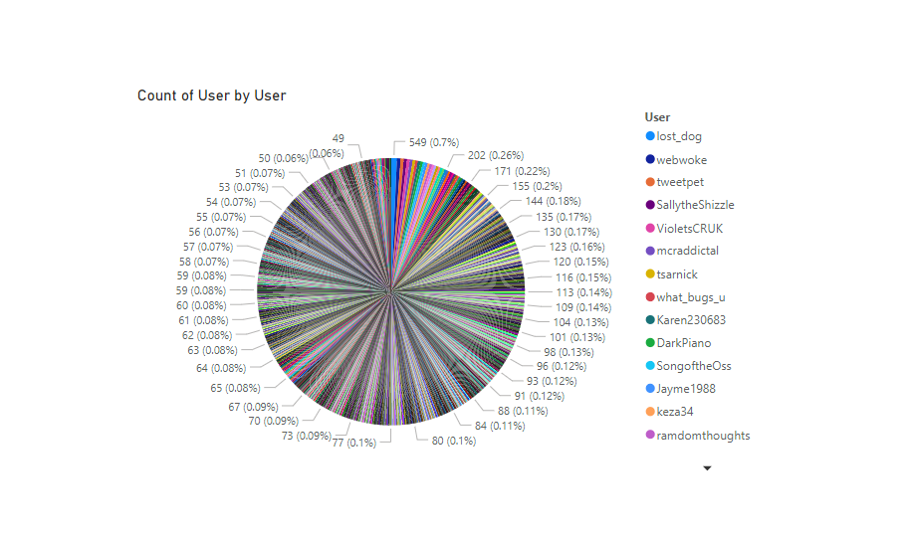
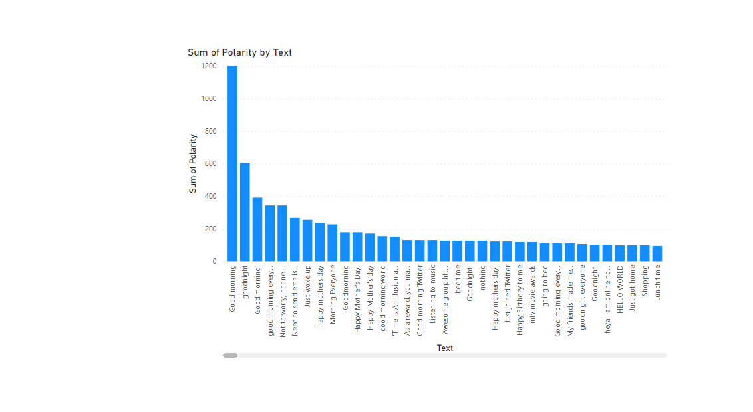
Visualisations using Power-bi

Slide 20
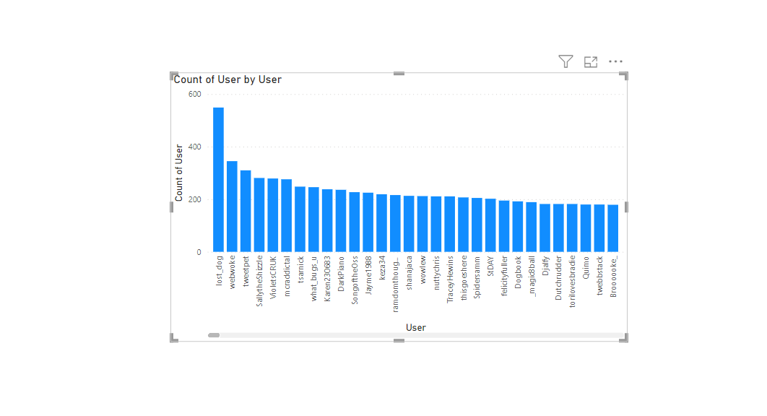
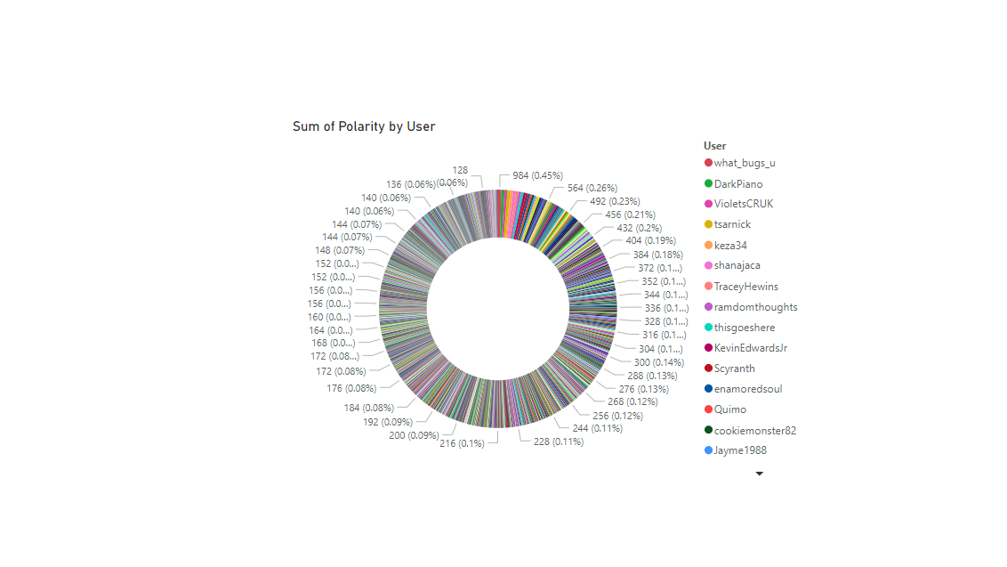
Visualisations using Power-bi

Slide 21

Project Findings
The model performed reasonably well with an accuracy of 77% in predicting the sentiment of a given tweet as either positive or negative.
Precision, recall, and F1-score values also indicated good performance, reflecting the model's balance in classifying both positive and negative tweets.
The model, using logistic regression, demonstrated that machine learning techniques could be effective tools for sentiment analysis, even on large-scale, unstructured text data like tweets.

Slide 22

Future Scope
While the model performed satisfactorily, there's room for further improvement and exploration:
The use of more advanced NLP techniques and models, like word embeddings (Word2Vec, GloVe) or transformers (BERT, GPT-3), could potentially improve the accuracy of sentiment analysis.
Deep Learning techniques, such as Recurrent Neural Networks (RNNs) and Long Short-Term Memory (LSTM) networks, could be employed to better capture context and semantics in tweets.
Implementing a system for handling negations and sarcasm could improve the model's understanding of tweets.
The model could be expanded to include multi-class sentiment analysis (e.g., very negative, negative, neutral, positive, very positive) or emotion detection (e.g., happy, sad, angry, etc.).
Additionally, real-time sentiment analysis could be implemented for live monitoring of sentiments on social media platforms.

Slide 23

Conclusion
The project successfully demonstrated the application of machine learning and NLP techniques in performing sentiment analysis on a large Twitter dataset. Despite the inherent challenges in processing and understanding unstructured text data, the model achieved good performance metrics, validating the effectiveness of these techniques in extracting meaningful insights from such data. With future enhancements and expansion, such sentiment analysis models have significant potential in various fields, from business and marketing to public policy and mental health.

